Slide 1









Capstone Project
Finance
Knowledge
Assistant
Intelligent Financial Agent Using Retrieval-Augmented Generation
IITM Pravartak DSA 03
Finance RAG | Capstone Project|| Guru Swaminathan | Narendran S| L.Ashok| Vignesh Ramachandran| S Chandrasekar | Chandrasekhar kypa| Dharmendra Kumar

Slide 2

Problem Statement &
Project Objective
Financial analysts and researchers struggle to quickly extract insights from structured financial statements. Manually querying balance sheets, income statements, and cash flow data across multiple companies is time-consuming and error-prone. There is a clear need for an intelligent assistant that can understand natural language queries and retrieve accurate, grounded answers from structured financial data — enabling faster, more informed decision-making.
Slow Manual Data Retrieval
Unstructured Query Handling
Multi-Company Data Complexity
Build a RAG Finance Assistant

Slide 3

Why This
Project Matters
Financial statements hold critical insights — but extracting them is slow, technical, and inaccessible to most stakeholders. Analysts spend hours parsing income statements, balance sheets, and cash flow reports just to answer basic questions.
This project bridges that gap. By enabling natural language queries on structured financial data from Indian IT companies, the Finance Knowledge Assistant transforms complex statements into instant, conversational insights — no SQL, no spreadsheets, no expertise required.
Faster decisions. Broader access. Smarter analysis.

Slide 4




z
Data Source & Scope
Yahoo Finance & Indian IT
Financial data was sourced from Yahoo Finance using the yfinance library, covering major Indian IT companies including TCS, Infosys, Wipro, HCL Tech, and Tech Mahindra. Three core financial statement types were ingested: balance sheets, income statements, and cash flow statements.
Yahoo Finance API
Indian IT Companies
Statement Types
Data Coverage
Data fetched via yfinance library with ticker symbols for top NSE/BSE listed IT firms.
TCS, Infosys, Wipro, HCL Tech, and Tech Mahindra covered across multiple fiscal years.
Balance sheets, income statements, and cash flow statements ingested as structured data.
Multi-year historical financial records providing rich context for RAG-based Q&A queries.

Slide 5


Data Pipeline
Overview
Yahoo Finance data is fetched using the yfinance library for Indian IT companies (TCS, Infosys, Wipro, HCL, Tech Mahindra). Three statement types are retrieved: income statement, balance sheet, and cash flow — forming the raw structured input.
Each dataframe is transposed and iterated row-by-row. Every financial metric becomes a Document object enriched with metadata: company ticker, statement type, and fiscal year — enabling precise retrieval and filtering downstream.
Raw
Dataframes
Document
Chunking
Metadata
Enrichment
Vector-
Ready Docs
Finance Knowledge Assistant — RAG Pipeline

Slide 6


Knowledge
Base Layer
Financial statements retrieved from Yahoo Finance are transformed into vector embeddings and stored in ChromaDB, enabling fast and semantically accurate retrieval for downstream RAG queries.
Each document chunk is embedded using a sentence-transformer model, capturing semantic meaning beyond keyword matching. ChromaDB persists these vectors locally, supporting filtered lookups by company, year, and statement type.
Chunking
Financial documents split into overlapping chunks to preserve context across multi-line statements and row boundaries.
Embeddings
Sentence-transformer model converts each chunk into a dense vector capturing semantic meaning.
ChromaDB
Vectors stored in a persistent local ChromaDB collection with rich metadata for filtered retrieval.
Similarity Search
Cosine similarity used to rank and retrieve the most relevant chunks for each user query.
Finance Knowledge Assistant — RAG

Slide 7
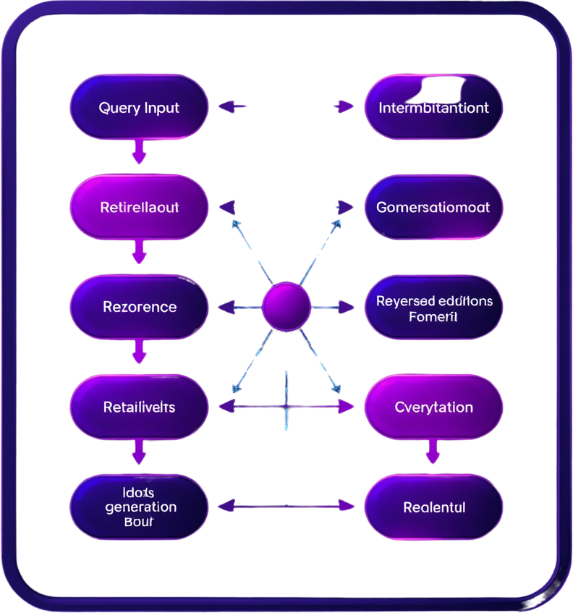


Conversational RAG
Architecture Overview
The system combines a retrieval pipeline with an LLM to answer finance queries. User questions are processed, relevant documents retrieved from ChromaDB, context assembled, and grounded responses generated.
Query Processing
Vector Retrieval
Context Assembly
LLM Generation
Grounded Response Delivery
Finance Knowledge Assistant — RAG

Slide 8


Conversation
Memory & Context
The Finance Knowledge Assistant maintains conversational continuity using a rolling chat history buffer. Each user query is enriched with prior exchanges before being passed to the retrieval pipeline, allowing the system to resolve ambiguous follow-up questions like "What about Infosys?" without losing context. The context window is carefully managed to balance memory depth with token efficiency, retaining the most relevant recent turns. A question-rewriting step reformulates vague or pronoun-heavy queries into standalone, retrieval-ready questions. This enables multi-turn dialogues over financial statements — users can drill into revenue trends, compare companies, or ask clarifying questions naturally, with the assistant grounding each response in the retrieved document context rather than hallucinating from prior conversation alone.
Chat History Buffer
Context Window Mgmt
Query Rewriting
Multi-Turn Dialogue
Finance Knowledge Assistant — RAG Capstone

Slide 9


Retrieval Pipeline &
Filter Logic
The retrieval pipeline transforms user queries into precise, context-aware answers by combining query embedding, metadata filtering, and semantic similarity search. Each step ensures only the most relevant financial data is surfaced. Metadata filters narrow the search space by company, statement type, and fiscal year, while cosine similarity ranking selects the top-k most contextually aligned document chunks for grounded answer generation.
Query Embedding
Similarity Search
Context Ranking
Metadata Filtering
Finance Knowledge Assistant — RAG

Slide 10

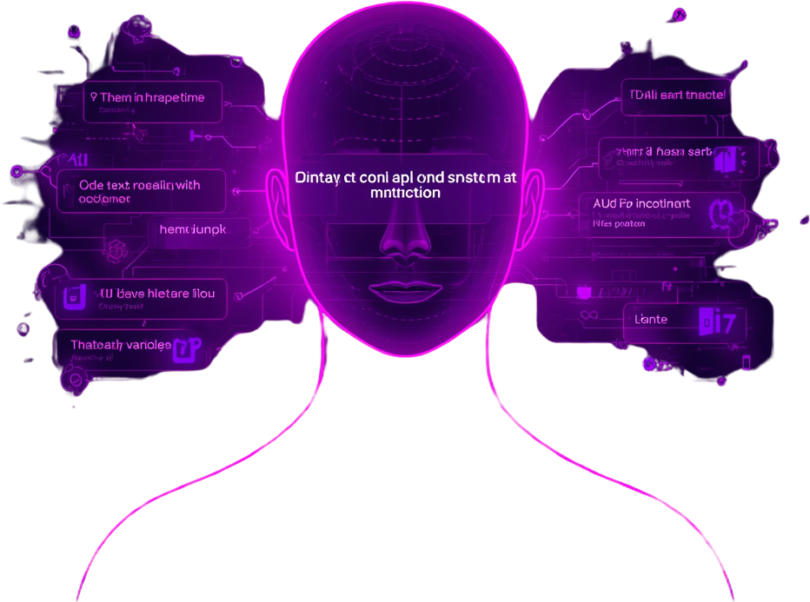
Grounded Answer Generation
Carefully crafted prompts ensure the LLM generates accurate, grounded responses from retrieved financial context.
• System Instructions: The LLM is instructed to answer only from provided context, avoiding hallucination or external knowledge.
• Context Injection: Retrieved document chunks — balance sheets, income statements, cash flows — are injected into the prompt as structured context blocks.
• Citation Requirements: The model is prompted to reference the specific company, statement type, and fiscal year when citing figures.
• Strict Grounding Rule: If the answer cannot be found in the retrieved context, the model responds with "I don't know" rather than guessing.
• Prompt Template: A consistent template separates system role, injected context, conversation history, and the current user query for clarity and reliability.

Slide 11

Chat UI &
User Workflow
The Gradio-based chat interface provides an intuitive workflow: users type a natural language financial query, the assistant retrieves relevant context from ChromaDB, and a grounded answer is displayed alongside source citations. Conversation history is preserved across follow-up questions for a seamless experience.
Query Input
Response Display
Conversation History
Source Citations

Slide 12

Key Outcomes,
Limitations & Future Improvements
The Finance Knowledge Assistant demonstrates strong retrieval accuracy and grounded answer generation. Below are the core outcomes achieved, known limitations, and planned enhancements for future iterations.
Accurate Retrieval
Grounded Answers
Data Scope
Memory & Context
Future Roadmap
ChromaDB vector search consistently retrieved the most relevant financial statements, enabling precise, context-aware responses across multi-turn conversations.
LLM responses are anchored to retrieved document chunks, minimizing hallucinations and ensuring all answers are traceable to source financial data.
Current limitation: data is restricted to Indian IT sector companies from Yahoo Finance. Cross-sector and global coverage is not yet supported in this version.
Conversation memory handles follow-up questions effectively within a session, though long conversation histories may dilute retrieval precision over time.
Planned: multi-source ingestion (SEC, NSE), real-time data refresh, expanded sector coverage, and a persistent user session memory layer.
Finance Knowledge Assistant — RAG Capstone

Slide 13

Finance RAG Capstone
Thank
You!
Ready for Demo — Finance Knowledge Assistant RAG

